Slide 1


COMP 2120 Object-Oriented Programming Using Java
Group 10 - BugEyed
Variant: 7
(CLI-Based Gym Management System)
Group Members:
Inan Syed
Paul Osuji
Temirlan Rashid

Slide 2
Agenda
Project Description
Main Project Tasks
Group Members & Their Contribution
Task Completion & Development
Live demo Demonstration
Reference
Agenda

Slide 3
Project Description
Objective:
Our CLI-Based Gym Management System is designed to streamline the operations of a gym using a command-line interface. This system allows gym staff to efficiently register and manage member details, schedule and manage fitness classes, and generate reports based on member, equipment, and fitness class data.

Slide 4
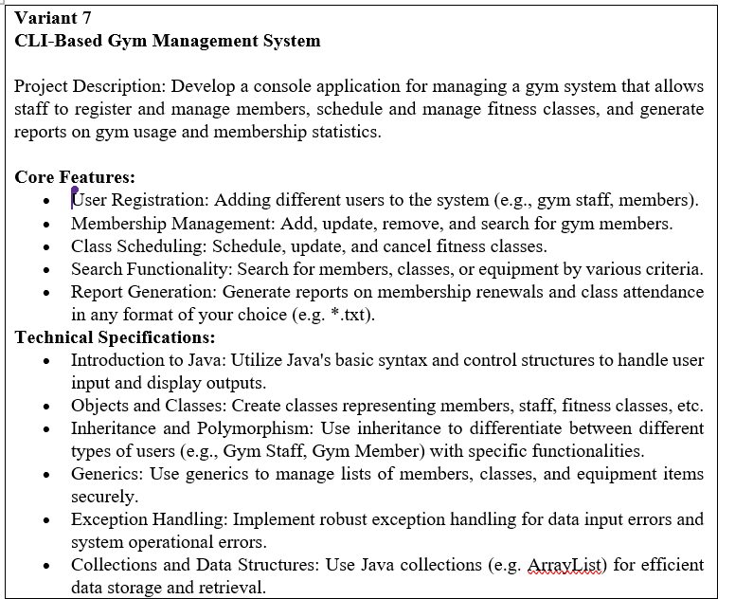
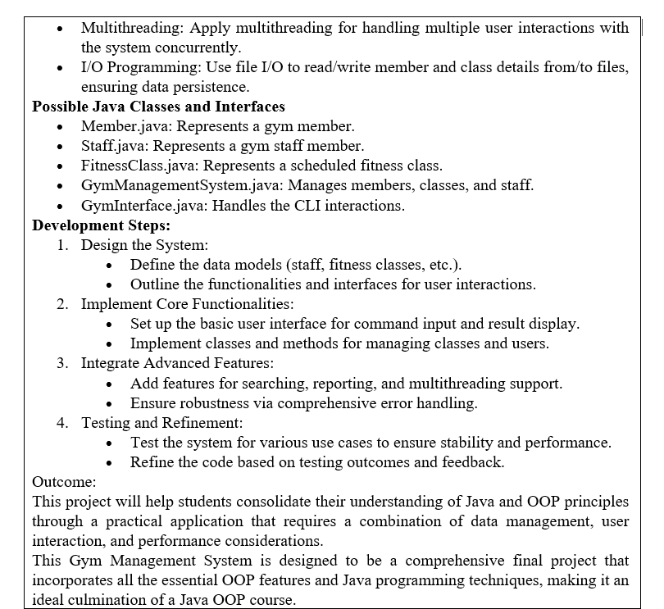
Main Project Tasks

Slide 5
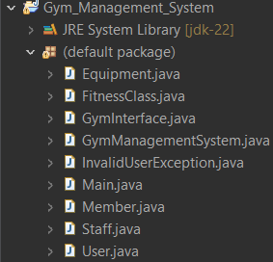
Group Members & Their Contribution
InanSyed
Core System Functionality: Developed core system functionality.
I/O Programming
Implemented I/O programming for the project, including a Load & Save method utilizing multithreading for efficient data handling.
AutoSave Features:
Created a toggle-autosave function to ensure consistent background data saving every 10 seconds.
Report Generation:
Contributed to the logic for generating comprehensive reports
Code Reviews:
Participated in code reviews to maintain code quality and consistency
Paul Osuji
Command-Line Interface:
Implemented the CLI to manage all user interactions.
GymManagement System Logic:
Managed Members, Staff, Equipment, and Fitness objects (adding, removing, updating, and searching).
Security Features:
Implemented login and logout functionality for basic system security.
Abstract User Class:
Created the Abstract User class as a common base for other classes.
Object Templates:
Developed templates for Member, Staff, Equipment, and FitnessClass.
Temirlan Rashid
Custom Exceptions:
Implemented the InvalidUserException class for error management.
ID Generation & Validation:
Contributed to unique ID generation and input validation (regex for email and phone number).
Polymorphism Logic:
Developed the logic behind polymorphism in the system.
Testing & Debugging:
Conducted extensive testing to identify errors and ensure system correctness.
Code Reviews:
Participated in code reviews to maintain code quality and consistency

Slide 6
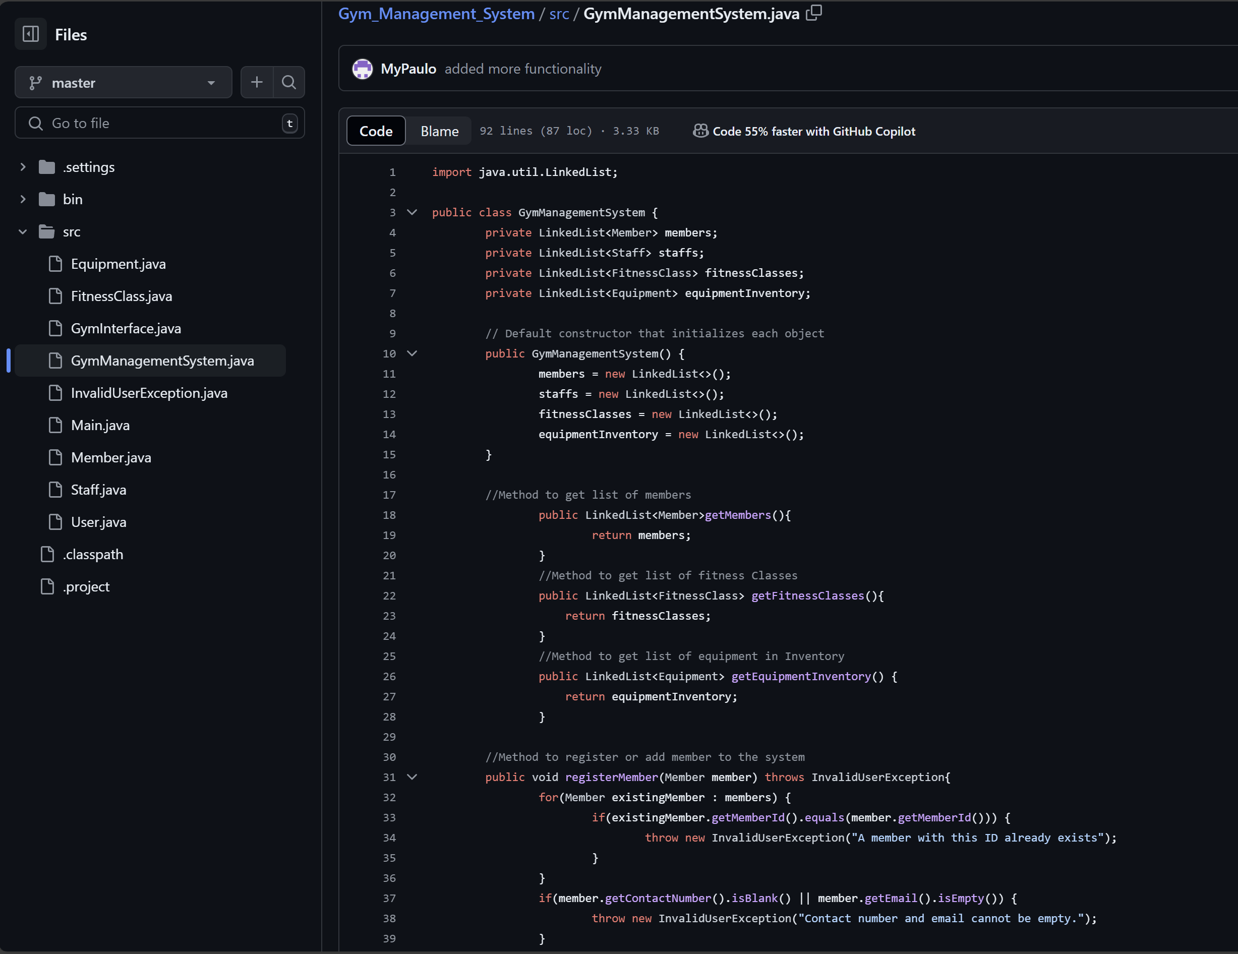
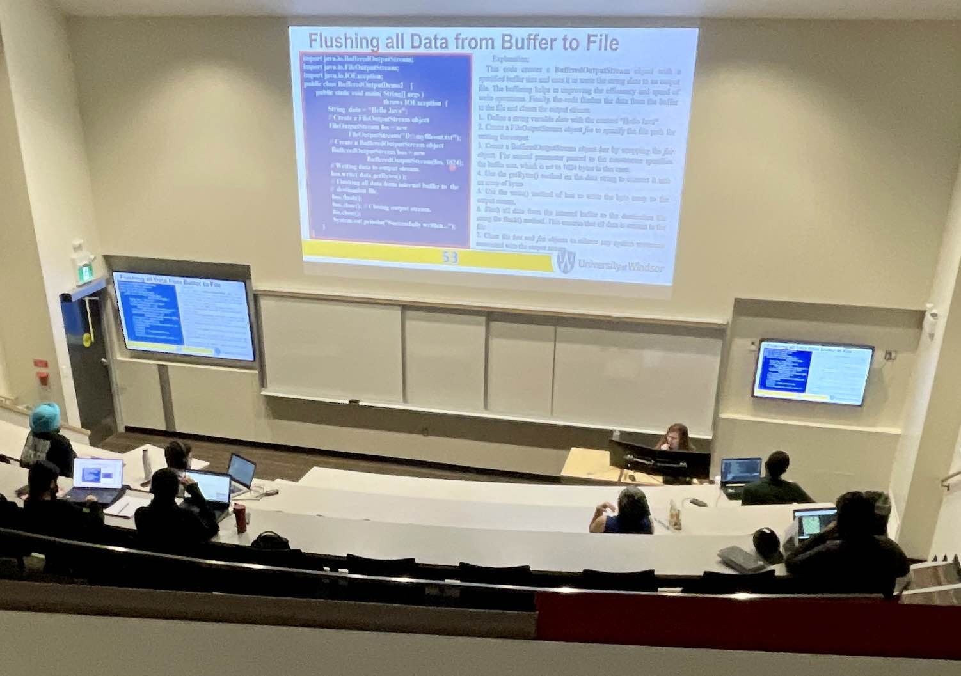
Task Completion & Development
Project Tasks & Features
Lecture Notes
Lab Sessions
Testing & Feedback on GitHub
Discord Chat & Meetings
Finalization & Delivery of Project

Slide 7

Live demo Demonstration
(give us a few seconds)

Slide 8
REFERENCES
Java Platform SE 8. (2020). Oracle.com. https://docs.oracle.com/javase/8/docs/api/
Lecture 2: Objects and Classes in Java
Lecture 3: Inheritance, Polymorphism, and Generics
Lecture 4: Exception Handling
Lecture 6: Data Structures and Collections – 2
Lecture 8: I/O Programming

Slide 9

QUESTIONS?

Slide 10

Thanks!:>

